Slide 1
English Writing II
Week 14 Writing about the Method

Slide 2
In today’s lesson
Review of the Research questions
Writing about the Method

Slide 3

Fast reading (first round) 12 minutes
Four articles from SSLA
Title & abstracts
Research questions
IMRD structure
Style of language

Slide 4
Four articles
“Analytic Ability” Research paper (Analytic ability).pdf
“Oral Fluency” Research paper (Oral Fluency).pdf
“Articulatory Skills” Research paper (Articulatory Skills).pdf
“Pausing in Writing” Research paper (Pausing in Writing).pdf

Slide 5
“Analytic ability”

Slide 6
“Articulatory skills”

Slide 7
“Pausing in Writing”

Slide 8
“Oral fluency”

Slide 9
Method
Research method/ Research design/ Research methodology
Observation (participant and non-participant)
Surveys (questionnaire) and Interviews
Experiments and quasi-experiments
Case studies
Mixed Methods (combination of some of the above)

Slide 10

Fast reading (second round) 12 minutes
The part of Method
Major components?
Sequence of writing?
Style of language?

Slide 11
Components of the Method part
Participants/ subjects
Instruments/ materials
Procedures
Measurement of the variables/ data type
Data analysis

Slide 12

Participants
Sampling, recruiting and grouping (criteria & procedure)
Demographic information
Other relevant information
Privacy and confidentiality
→ voluntary participation, informed consent

Slide 13
“Articulatory skills”

Slide 14
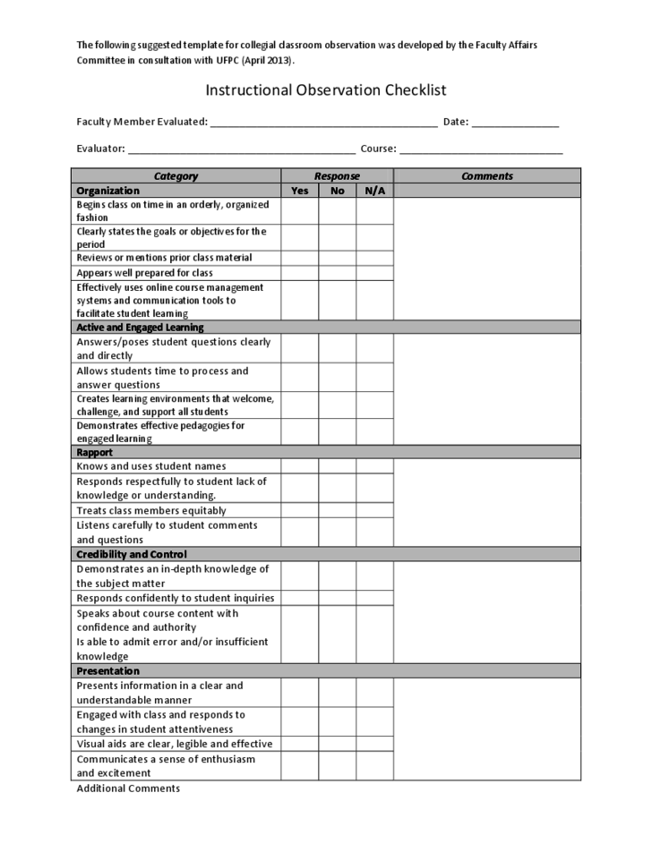
Instruments/ materials
Treatments
Tests and exams
Questionnaires
Observation checklist
Source: Original or adapted?

Slide 15
“Pause in Writing”

Slide 16
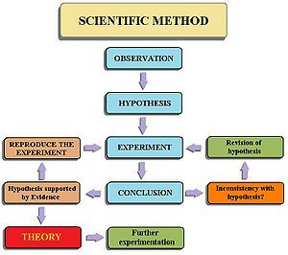
Procedure
Step-by-step description (a flowchart)
Time, place, people, material, etc.
Stage 1 → Stage 2 → Stage 3
Pre-test→ Treatment → Post-test → Delayed post-test

Slide 17



Measurement and data treatment
Data types – scores? Percentage number? Other treatment?
Statistical tools (EXCEL, SPSS) and editions?
Research paper (Articulatory Skills).pdf

Slide 18
Language features
Simple past tense
Passivization
Specific and accurate
Academic and formal (vs. conversational)

Slide 19
In-class writing 1401 10-15 minutes
The key information for different components of Method
Subjects/Participants
Materials/ Instruments
Procedure
*Data types and treatments

Slide 20
Assignment
Revise and formulate the research questions
Optimize the research method
Carry out the research (1 days’ work)
Preliminary analysis of the data obtained

